Slide 1
Online Food Delivery analysis By Pradeep R

Slide 2
Challenges in the dataset
There were multiple columns with many null values which we had to replace with the median values.
There were multiple columns which had multilevel categorical variables which were then reduced into fewer levels.
Analyzing the outliers from all the variables and treating the outliers in an appropriate manner.

Slide 3
My Learning
The first and foremost learning was to implement the theoretical knowledge that help to solve the real world problem.
I learnt that the data is valuable so we should not manipulate it too much.
I learnt that, a good model of linear regression can only be obtained by doing lot of trails.
I learnt that we should think out of the box.
I learnt about insurance data set and how it is used.

Slide 4
Major insights through EDA

Slide 5
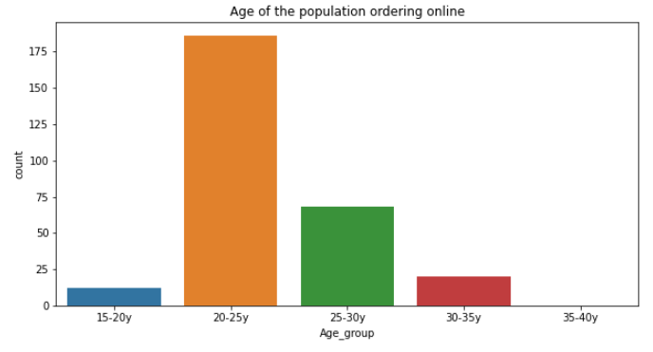
The age group 20-25 years old is the one that needs to be targeted because this group is the one that orders the most. The group 25-30 years old needs to be studied much better because this group has the ability to increase revenue as it is second most age group that orders the most.

Slide 6
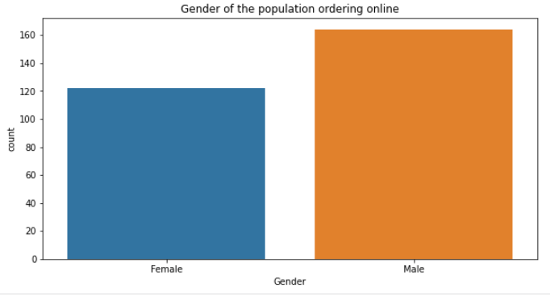
Male orders more than female.

Slide 7
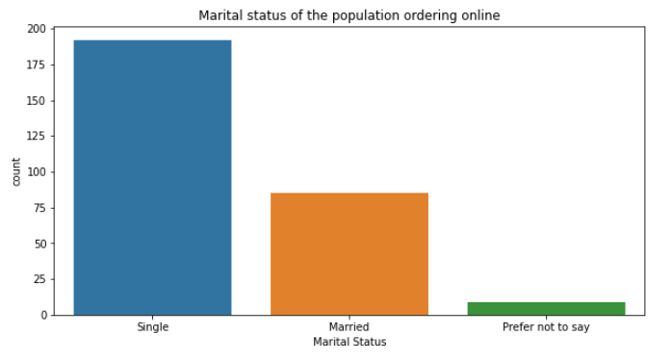
Maximum online order comes from single followed by married.
Reason for more order by single people-
1)Sharing the flat with a number of people and in that scenario they prefer to order online than cooking as the cook cannot always cook different types of food for different people.
2)Too much workload.
3)Off days people prefer to relax.

Slide 8
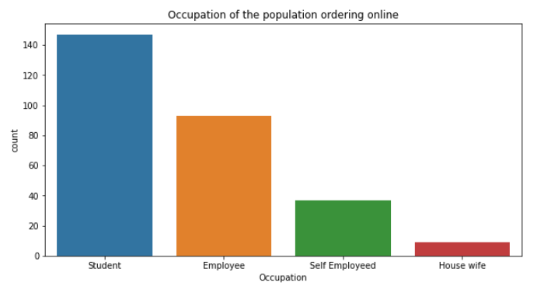
Students then followed by employee order the most and minimum is housewife.

Slide 9
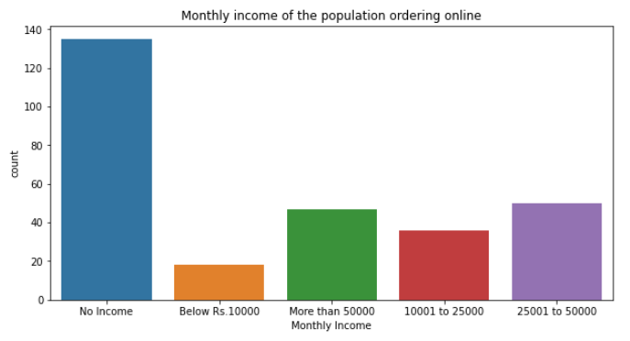
People with no income order most as in occupation graph we saw that it was the students who ordered most. So a student does not have income. After the students there were employee earning more than 25 thousand but less than 50 thousand order the most.

Slide 10
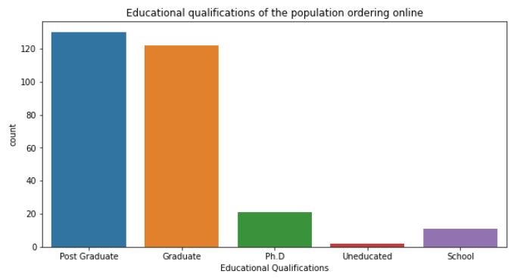
As most students order online. After analysing their qualifications it was found that the post graduate students ordered the most.

Slide 11
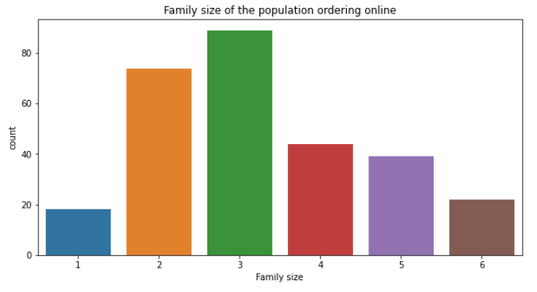
Family size of three ordered the most.This column can be set aside as it does not present clear picture as other columns present among themselves.

Slide 12
Conclusion
1)Customer-the apetite of customer leads to a business running successfully . So more ways and ideas should be thought about to make them order more.This should be the top most goal of the business owner.
2)Delivery Partners-They act as a mode of communication between a customer and the restaurant .So thinking about their well being is necessary for a business to flourish.
3)Restaurants-Their food is the one which has made this business turn into a profit making one.So they should come up with ideas to make it more customer centric.

Slide 13
Thank You

